Slide 1

Sazerac SWOT Analysis Using Iowa Liquor Sales Data
By: Mina Saeday
Notes:
This presentation analyzes Sazerac’s sales performance using the Iowa Liquor Sales database and frames the results through a SWOT lens.

Slide 2
scenario
Objective:evaluate Szerac's market position using transaction level sales data
Method: SQL analysis in PG admin, visual summaries in Excel
Focus: strengths,weaknesses,opportunities,and threars tied to revenue,products,geography, and competition
Notes:
My goal was to use SQL to translate raw sales data into business findings that are useful for decision-making.

Slide 3
Summary Stats for DB
Database tables used: sales, products, stores, counties
Primary focus: vendor = Sazerac
Key fields analyzed: revenue, product description, county, store, bottle cost, category
Tools used: PostgreSQL/pgAdmin and Excel
Notes:
The analysis combines transaction data with product, store, and county reference tables to evaluate Sazerac from multiple business angles.

Slide 4
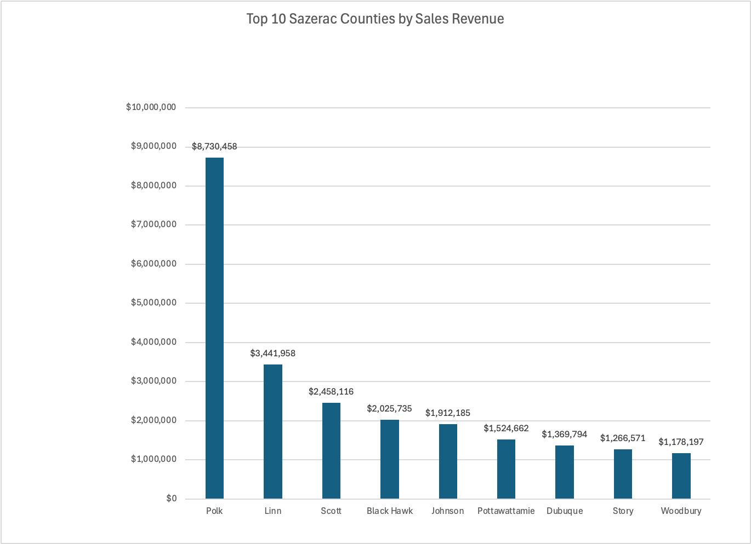
Strength: Strong Geographic Performance
Sazerac revenue is concentrated in high-performing counties, with Polk County clearly leading.
Notes:
This chart shows where Sazerac performs best geographically. Polk County is the strongest market by a wide margin, followed by other high-revenue counties such as Linn and Scott.

Slide 5
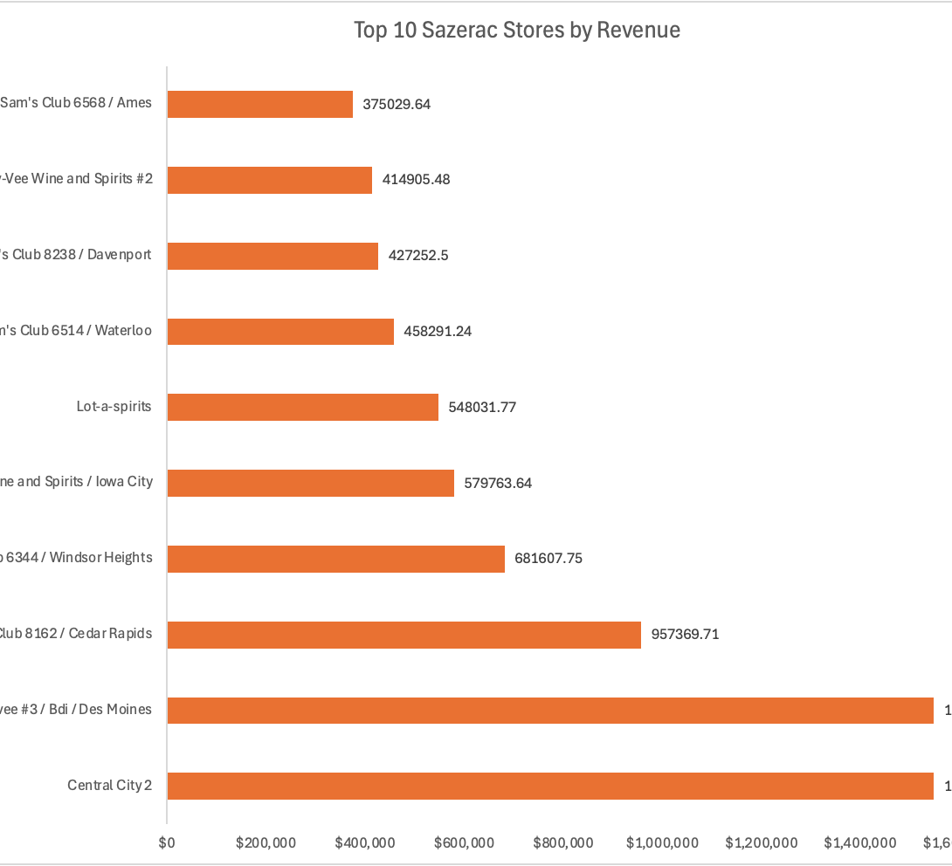
Weakness: Revenue Concentration Across Stores
A relatively small group of stores contributes a large share of revenue
This creates partner concentration risk
Notes:
This chart is useful not only for identifying top partners, but also for showing concentration risk. If a few stores account for a disproportionate share of revenue, Sazerac’s performance becomes more exposed to changes at those retail partners.”

Slide 6
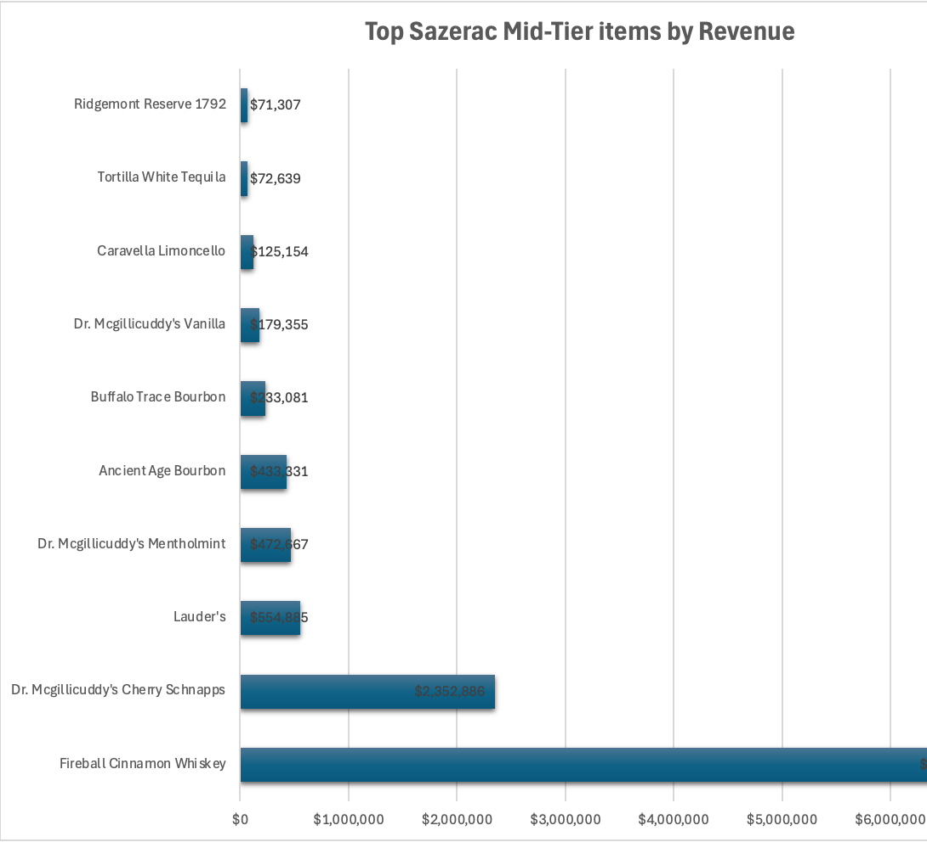
Opportunity: Mid-Tier Price Segment
Mid-tier products generate meaningful revenue
A few items dominate within the $10–$20 state bottle cost range
Notes:
This chart focuses on the mid-tier bottle cost bracket. The opportunity here is that Sazerac already has products performing in this price segment, so there may be room to strengthen positioning around value-oriented but profitable items.

Slide 7
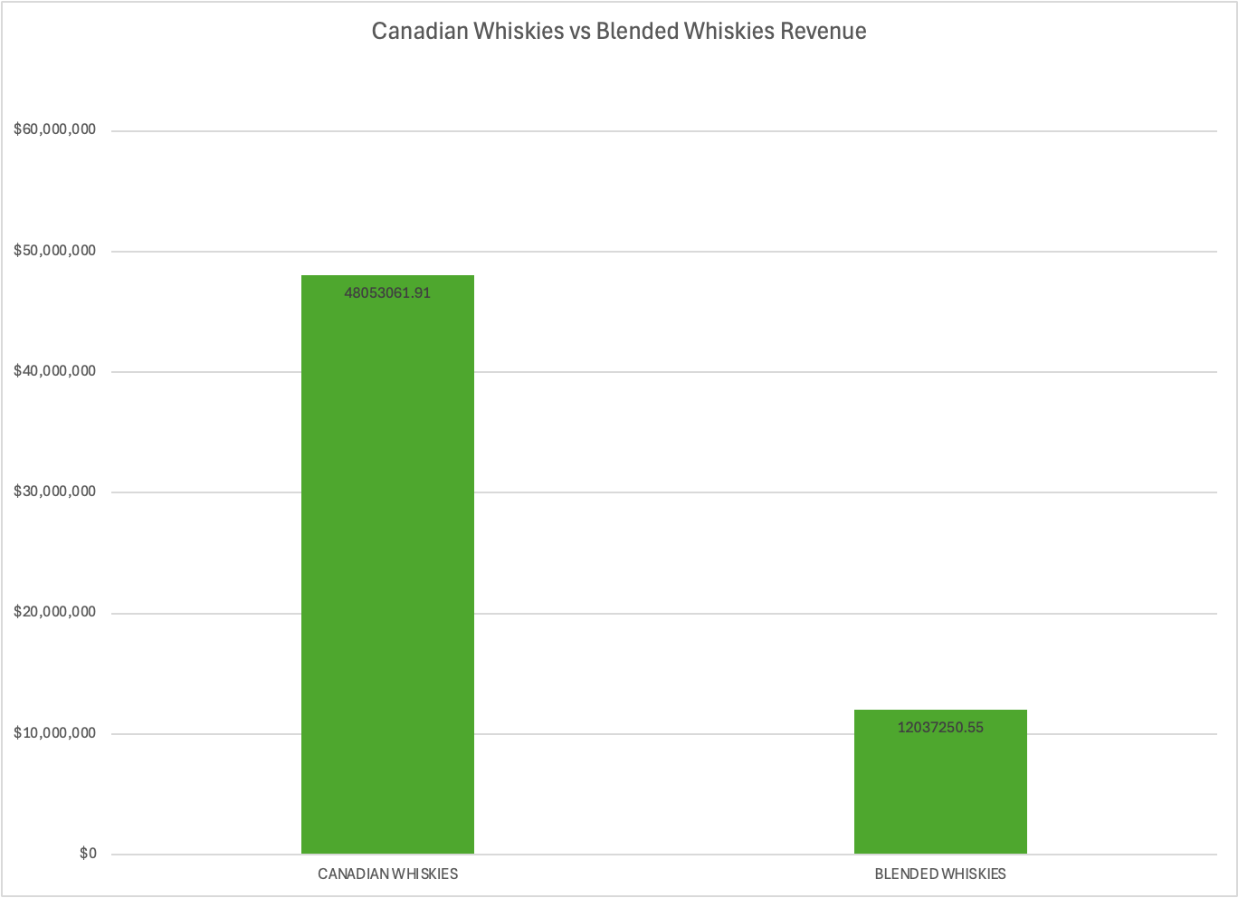
Threat:Competitive Substitute Categories
Canadian Whiskies generate substantially more revenue than Blended Whiskies
Category competition remains important in the substitute space
Notes:
This comparison helps frame the competitive environment. Canadian Whiskies materially outperform Blended Whiskies in this dataset, which indicates a stronger substitute category space and highlights where competition for share is most relevant

Slide 8
SUMMARY AND RECOMENDATION
Defend and deepen share in high-performing counties, especially Polk
1
Prioritize flagship items, led by Fireball Cinnamon Whiskey
2
Expand selectively in mid-tier and urban market segments where demand is already visible
3
Notes:
My recommendation is to protect the core first, especially strong counties and hero products, while using mid-tier pricing and urban-market demand as the main levers for targeted growth.

